Slide 1


Brain computer interface:future human computer interaction
PRESENTED BY
TEAM
NEUROX

Slide 2
INTRODUCTION
A Brain-Computer Interface (BCI) is a system that enables direct communication between the brain and a computer.
It allows people to control machines using their thoughts, without physical movement.
BCIs are revolutionizing how humans interact with technology.

Slide 3

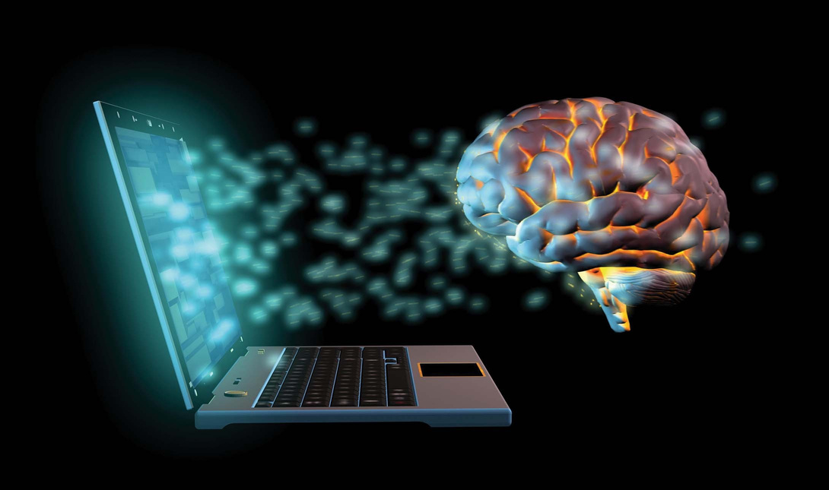
How BCI'S Work:
Technical perspective
1. Signal Acquisition: Electrodes capture brain signals (EEG or implants).
2. Signal Processing: The computer decodes brain activity into commands.
3. Output: The device performs the desired action.
4. Feedback: The brain adapts, improving control over time.
They are two types:
invasive and non invasive

Slide 4
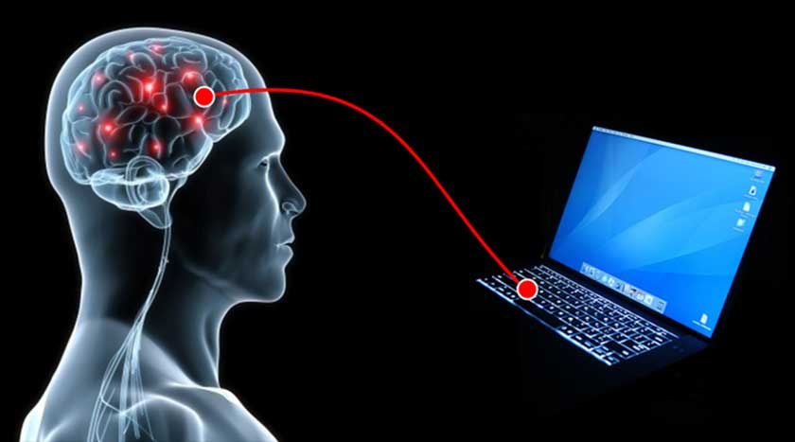

Future possibilities:
1. Medical Restoration & Enhancement
2. Thought-Based Communication
3. Human–Machine Control
4. Brain-to-Brain Communication

Slide 5
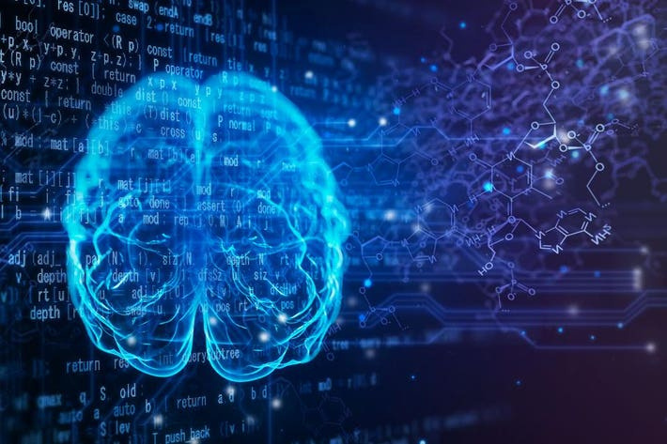
Ethical concerns:
Privacy: Brain data could be misused or hacked.
Manipulation: Risk of influencing human thoughts.
Inequality: High cost may widen the social gap.
Health Risks: Brain implants can cause infection or damage.
Regulation: Lack of global laws for neurotechnology.

Slide 6
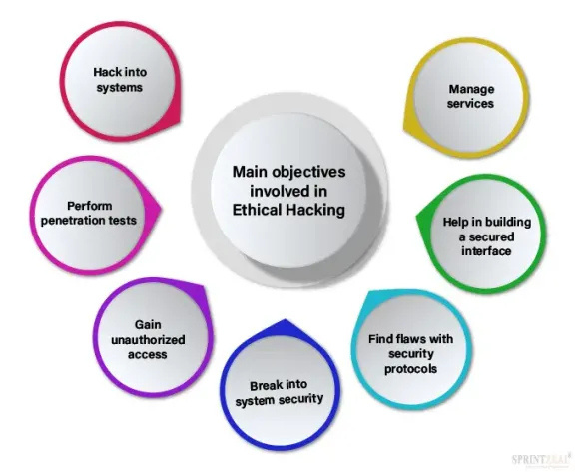

SOLUTIONS TO ETHICAL CONCERNS
Implement strict data protection and encryption.
Ensure one-way data flow (brain → machine).
Promote affordable BCIs for healthcare access.
Develop non-invasive technologies for safety.
Create international neuroethics regulations.

Slide 7
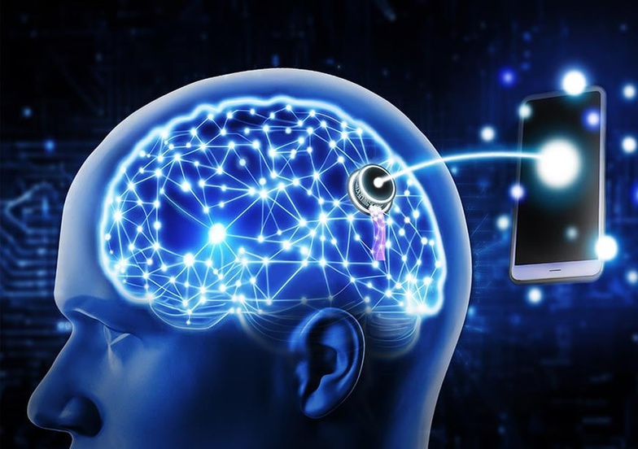
Social and economic perspective
Social and Economic Perspective
Improves life for people with disabilities
Transforms human interaction
Privacy and cost may create inequality
Growing industry creating jobs in tech & healthcare
Affordable and ethical use is essential

Slide 8

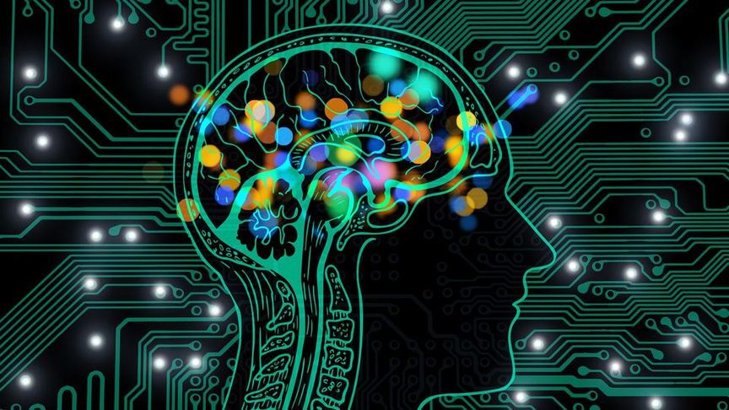
Challenge's and regulations
Challenges and Regulations
High cost and technical limitations
Signal accuracy and health risks
Limited skilled researchers
Lack of global neurotechnology laws
Need for strong regulations and ethical guidelines

Slide 9
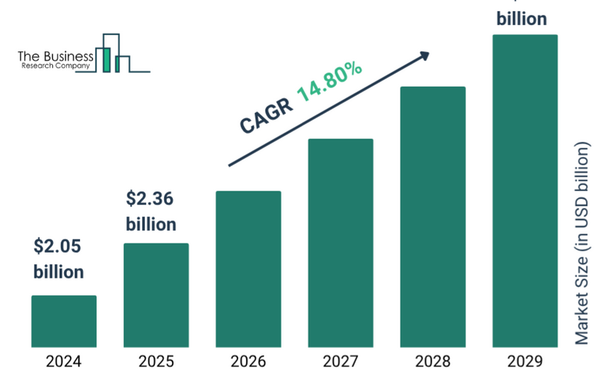

Global and Indian scenario
Global and Indian Scenario
Global: Neuralink (USA), Synchron, DARPA research.
India: IIT Madras & IISc Bangalore working on neuroprosthetics.
Future Goal: Make BCIs part of inclusive digital healthcare.
India is slowly emerging in the neurotech field.

Slide 10
Conclusion
> Brain-Computer Interfaces are redefining how humans and computers interact.
They hold the potential to empower people, expand human abilities, and reshape the digital world.
But to ensure a safe and inclusive future, we must balance innovation with ethics.

Slide 11
THANK YOU
Team NeuroX

